Slide 1



LEBANESE INTERNATIONAL UNIVERSITY
Rent à Porter
By Mohammad Ali Jaber

Slide 2
Introduction
Welcome to the presentation on my project, "Rent a Porter" a rental dresses website designed to revolutionize access to designer fashion. The primary goal of this project is to enable people to wear high-end designer dresses without worrying about the significant costs associated with purchasing them. Also providing a platform for individuals to monetize their wardrobe by renting out their dresses.

Slide 3
Technology Used
Software needed: Visual Studio Code, Xampp, Chrome Web browser
Languages: php, javascript, html, css, MySQL
Frameworks and Libraries: bootstrap, W3Schools
Hardware: laptop

Slide 4
Steps Undertaken
Market Research and Requirement Gathering
System Design and Architecture Planning
Database Design
Frontend Development
Backend Development
Testing and Debugging

Slide 5
Scope and Achievements
Scope:
Target Audience
Fashion Enthusiasts
Event-Goers
Lenders
Geographic Reach
Local Reach
International Potential
Key Functionalities
Registrations and Profiles
Dress Catalog
Search and Filter Options
Rental Process

Slide 6
Scope and Achievements
Achievements:
Successful Implementation of the Rental System
User-Friendly Interface
Secure and Efficient Transaction Processing
Enhanced Customer Satisfaction

Slide 7
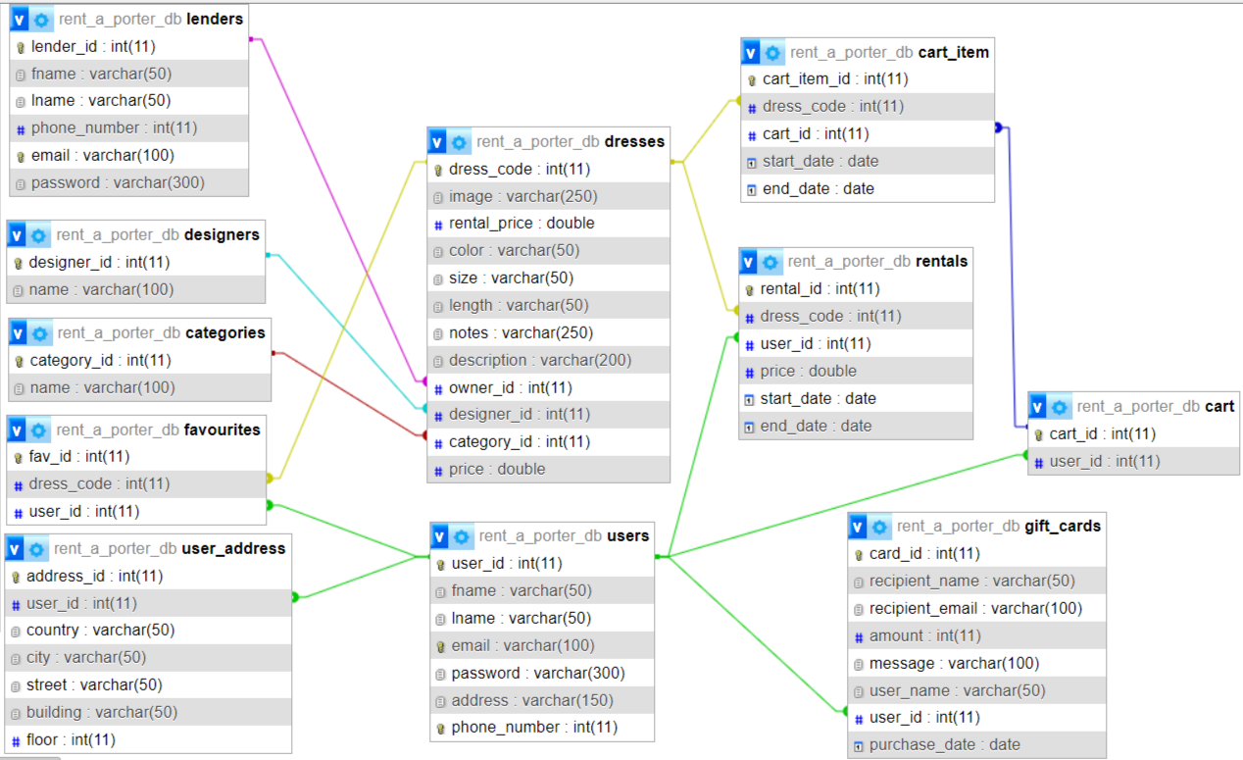
Database Structure

Slide 8
Final Result
Browse and search for dresses
Successful rental process
Secure checkout process
User profile management
Lender registration and management
Dress submission

Slide 9
Future Enhancements
Mobile App Development
AI Integration
International Expansion

Slide 10
Thank
You
Presented by Mohammad Ali Jaber

